Slide 1

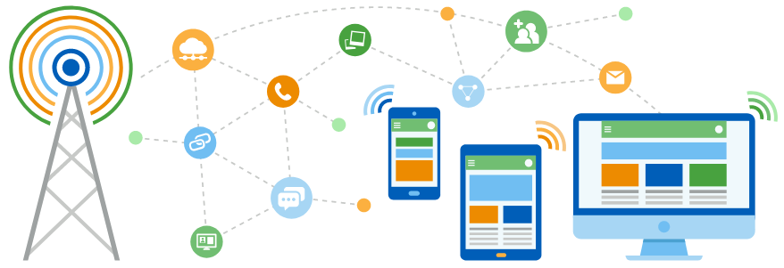
Faculty of Computing and Informatics
Department of Computer Science
IT Infrastructure Administration and Services
ITA711S
2023 - Semester 1
Event Specific Picture – behind red graphic
Chapter 8
HTTP Overview

Slide 2
Outline
What is HTTP
HTTP Transactions
How HTTP works
HTTP Requests and Responses
Request Methods
Server Responses
HTTP Status Codes

Slide 3
HTTP Overview
Hypertext Transfer Protocol
Set of rules for transferring files such as text, images, sound, video and other multimedia files over the web.
As soon as a user opens their web browser, they are indirectly using HTTP.
The latest version of HTTP is HTTP/2, which was published in May 2015. The earlier version is HTTP 1.1
HTTPS is the use of Secure Sockets Layer (SSL) or Transport Layer Security (TLS) for security enhancement.
HTTPS encrypts and decrypts user HTTP page requests as well as the pages that are returned by the web server. It also protects against eavesdropping and man-in-the-middle attacks.
HTTPS offers an added layer of security and trust.

Slide 4
HTTP Transactions
HTTP is a protocol that allows Web browsers to talk to servers and exchange information.
HTTP provides a standard way of communicating between browsers and web servers.
Any browser can talk to any server, provided that they both conform to the HTTP specification.
HTTP expects the client to initiate a request and the server to respond.
Each request and response has three parts namely the request/status line, header and the entity body.

Slide 5
How HTTP works
A web server contains an HTTP daemon that waits for HTTP requests and handles them when they arrive. A web browser is an HTTP client that sends requests to servers.
The HTTP daemon in the destination server receives the request and sends back the requested file or files associated with the request.

Slide 6
HTTP Request / Response
Each interaction between the client and server is called a message. HTTP messages are either requests or responses.
A client (a browser) sends an HTTP request to the web
A web server receives the request
The server runs an application to process the request
The server returns an HTTP response (output) to the browser
The client (the browser) receives the response

Slide 7
Request Methods (1)
Client devices submit HTTP requests to servers, which reply by sending HTTP responses back to the clients.
The request line of a client request contains an HTTP command called a request method
The server uses the method command to determine what to do with the request.
The most widely used methods are GET, HEAD and POST
If you analyze the packets using a packet sniffer you will discover that the method should be in uppercase.

Slide 8
Request Methods (2)
GET requests a specific resource in its entirety
HEAD requests a specific resource without the body content
POST adds content, messages, or data to a new page under an existing web resource
PUT directly modifies an existing web resource or creates a new URI if need be
DELETE gets rid of a specified resource
TRACE shows users any changes or additions made to a web resource
OPTIONS shows users which HTTP methods are available for a specific URL
CONNECT converts the request connection to a transparent TCP/IP tunnel
PATCH partially modifies a web resource

Slide 9
Request Methods (3)
The specific version of HTTP followed.
A URL. This is a pointer to the resource on the web.
An HTTP method. This indicates the specific action the request expects to receive from the server in its response.
HTTP request headers. This includes data such as what type of browser is being used and what data the request is seeking from the server.
An HTTP body. This is optional information the server needs from the request, such as user forms, username/password logins, short responses and file uploads, that are being submitted to the website.

Slide 10
The GET method
The GET method is used to retrieve information from the server.
In most cases it is used to retrieve documents from the web server.
Requests using GET should only be used to request data (they should not include data).
The document returned by the server could be a static HTML document, output generated by CGI (Common Gateway Interface) program or it could be an error generated by the server if something is wrong with request.
The GET method can pass information to the server (usually to a CGI program) but it must be included as part of the URL.

Slide 11
The HEAD method
The HEAD method is the same as the GET method except that the server does not return a document.
It returns only the header section for the request.
The HEAD method is useful for verifying that a document exists for checking links or to get information about the file type and modification time only.

Slide 12
The POST method
The POST method allows the server to receive data from the client.
It is most commonly used to send the data in HTML forms to the server for processing.
This method passes data to the server in the entity body of the request.

Slide 13
Server Responses (1)
After an HTTP server receives a request it attempts to process the request.
If a document is requested the webserver will attempt to find the document and return it.
If form information is passed to the server the HTTPD passes the information to the appropriate resource for processing and returns any output.
If the resource requested cannot be located or if there is something wrong with the request itself the server generates an error.
The server response, like the client request, has three parts: the status line, header field and the entity body.

Slide 14
Server Responses (2)
HTTP status code, which indicates the status of the request to the client device. Responses may indicate success, an informational response, a redirect, or errors on the server or client side.
The status code is a three digit integer result code defined by the HTTP specification
HTTP response headers, which send information about the server and requested resources.
An HTTP body (optional). If a request is successful, this contains the requested data in the form of HTML code, which is translated into a web page by the client browser.

Slide 15
Server Responses (3)
There are currently five categories:
1xx Informational :- the request was received and is being processed
2xx Success :- the client request was successful
3xx Redirection :- the client request was not performed; further action must be taken by a client
4xx Client error :- the client’s request was incomplete or incorrect and cannot be fulfilled
5xx Server error :- the request was not fulfilled, due to a server problem

Slide 16
Examples of HTTP status codes
1xx – Informational
  100 – continue
  101 – switching protocol
  102 – processing
2xx – Success
  201 – created
  202 – accepted
  203 – non-authoritative information
  204 – no content
3xx – Redirection
  301 – moved permanently
  302 – found
  303 – see other
4xx – Client error
  400 – bad request
  401 – unauthorised
  403 – forbidden
5xx – Server error
  501 – not implemented
  502 – bad gateway
  503 – service unavailable

Slide 17

End

